Slide 1

What is a Process
A process is an executing instance of a program. There can be multiple processes of the same program running at the same time
A process includes resources like
open files
processor state
a memory address space
one or more threads of execution

Slide 2
Threads
Threads are the parts of a process that contain the program counter, process stack, and processor registers.
The kernel schedules threads rather than processes
Note: Linux does not differentiate between threads and processes. To Linux a thread is just a special kind of process

Slide 3

Lifecycle of a Process
A process is created using the fork() system call.
The new process that’s created, the child process, inherits from the parent process that was active when fork() was called.
The exec() system call family creates a new address space and loads a new program into it
The exit() system call terminates a process and frees its resources.

Slide 4
Process state
TASK_RUNNING means the process is either currently running or on a run queue waiting to run.
TASK_INTERRUPTIBLE means the process is waiting for some condition to exist
TASK_UNINTERRUPTABLE is the same as TASK_INTERUPTIBLE except the process will not awake prematurely if it receives a signal.
__TASK_TRACED means the process is being traced by a program like ptrace.
__TASK_STOPPED means the process is no longer being executed. This occurs when the task receives the SIGSTOP, SIGTSTP, SIGTTIN, or SIGTTOU signal.

Slide 5
Process context
Process usually runs in user space
But when the process executes a system call the processor enters kernel space, where the kernel executes on behalf of the process.

Slide 6
Process tree
All processes are descendants of the init process.
The init process is started by the kernel as the last step in the boot process
It is now replaced by system → run the command ‘pstree’ in Centos 7 to verify

Slide 7
Process Scheduler
The process scheduler is responsible for choosing which processes run and for how long. A scheduler is the basic part of a multitasking operating system like Linux.
The amount of time a process runs is usually determined before it is scheduled, this is called the timeslice

Slide 8
Scheduling policies
Scheduling policies are the rules the scheduler follows to determine what should run and when
Scheduling policy is based on the following parameters:
Process priority
Timeslice
Scheduling policy in action

Slide 9
Scheduling policies – Continued…
Priority scheduling
One type of scheduling algorithm is Priority scheduling, which gives different tasks a priority based on their need to be processed.
Higher priority tasks are run before lower priority tasks
Processes with the same priority are scheduled round-robin style
Priority is based on 2 factors:
Nice Value
The nice value is a number from -20 to +19 with a default of 0.
The larger the nice value, the lower the priority
Real-time Priority Value
The real-time priority value can range from 0 to 99
The real-time value behaves the opposite of the nice value: a higher value means higher priority

Slide 10
Scheduling policies – Continued…
Timeslice
The timeslice value represents how long a process can run before it is preempted.
The scheduler policy must decide on a default timeslice.
The default timeslice is important
too long and the system will seem unresponsive
too short and the system becomes less efficient as the processor spends more time performing context switches between processes
Commonly, default timeslice value is 10ms

Slide 11
Scheduling policies – Continued…
Scheduling policy in action
Imagine a machine that is running only two processes: a video encoder and a text editor. The video encoder is CPU-bound, whereas the text editor is I/O-bound, because it spends much of its time waiting for user input.
The text editor should respond instantly when it receives a key press, but the video encoding can afford some latency. It doesn’t matter to the user if there’s a half second delay encoding the video, whereas a half second delay on the text editor would be noticeably laggy.
If both processes have the same nice value, they will be allocated 50% of the processor. The text editor will not use much of its allocated processor time because it will spend so much time blocked, waiting for I/O. The video encoder will be able to use more than its 50% of processor time. However, when the text editor wakes up in response to user input, CFS will see that the text editor has used less than its allotted 50% and therefore less time than the video encoder. It will then preempt the video encoder and run the text editor, enabling the text editor to respond quickly to user input

Slide 12
Latest Scheduling - Fair scheduling
CFS is based on a simple concept: Model process scheduling as if the system had an ideal, perfectly multitasking processor. In such a system, each process would receive 1/n of the processor’s time, where n is the number of runnable processes, and we’d schedule them for infinitely small durations, so that in any measurable period we’d have run all n processes for the same amount of time

Slide 13
Context Switching
Context switching is the switching from one runnable task to another. This is handled by the context_switch() function, which is called by schedule() when a process has been selected to run.
Context switching:
Switches the virtual memory mapping using switch_mm().
Switches processor state using switch_to().

Slide 14


Scheduler related system calls
System calls to set process priority, and scheduling policy
nice() Sets a process’s nice value
sched_setscheduler() Sets a process’s scheduling policy
sched_getscheduler() Gets a process’s scheduling policy
sched_setparam() Sets a process’s real-time priority
sched_getparam() Gets a process’s real-time priority
sched_get_priority_max() Gets the maximum real-time priority
sched_get_priority_min() Gets the minimum real-time priority
sched_rr_get_interval() Gets a process’s timeslice value
sched_setaffinity() Sets a process’s processor affinity
sched_getaffinity() Gets a process’s processor affinity
sched_yield() Temporarily yields the processor to other waiting tasks.

Slide 15
How to trace system calls made by a process with ‘strace’
In order to inspect what a running application is doing under the hood, and what system calls it is performing during its execution, we can use the 'strace' utility
strace is a tool used to keep track of the system calls made by a running process and the signals received by it.
System calls are the fundamental interface between an application and the Linux kernel; when we use strace, the name of the calls made by a process, along with their arguments and return values are displayed on stderr
Each line in the strace output contains:
The system call name
The arguments passed to the system call in parentheses
The system call return value
Demo required on:
Filtering only specific system calls
Trace an existing and already running process
Summary/Report of the system calls

Slide 16
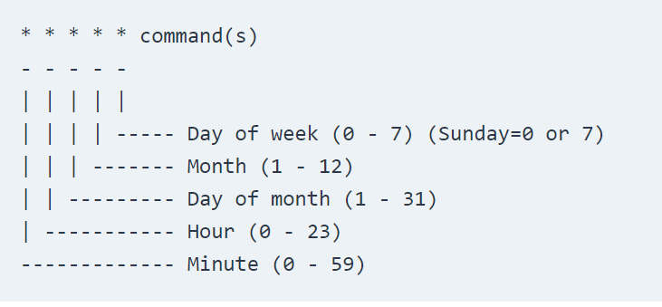
Cron Jobs in Linux
* - The asterisk operator means any value or always. If you have the asterisk symbol in the Hour field, it means the task will be performed each hour.
, - The comma operator allows you to specify a list of values for repetition. For example, if you have 1,3,5 in the Hour field, the task will run at 1 am, 3 am and 5 am.
- - The hyphen operator allows you to specify a range of values. If you have 1-5 in the Day of week field, the task will run every weekday (From Monday to Friday).
/ - The slash operator allows you to specify values that will be repeated over a certain interval between them. For example, if you have */4 in the Hour field, it means the action will be performed every four hours. It is same as specifying 0,4,8,12,16,20. Instead of asterisk before the slash operator, you can also use a range of values, 1-30/10 means the same as 1,11,21

Slide 17
Cron Jobs – Continued…
The crontab command allows you to install, view , or open a crontab file for editing:
crontab -e - Edit crontab file or create one if it doesn’t already exist.
crontab -l - Display crontab file contents.
crontab -r - Remove your current crontab file.
crontab -i - Remove your current crontab file with a prompt before removal.
crontab -u <username> - Edit other user crontab file. This option requires system administrator privileges.
Note: Cron is a daemon that allows you to schedule tasks at a specific date and time.
Examples:
Run a command at 15:00 on every day from Monday through Friday:
0 15 * * 1-5 command
Run a script every day, every hour, on the hour, from 8 AM through 4 PM:
00 08-16 * * * /path/to/script.sh

